Slide 1

Sustainable Catchment area Management Planning
‘SCaMP NI’
Dymphna Gallagher
Head of Drinking Water Regulation

Slide 2
NI Water - Drinking Water Catchment areas
    23 Water Treatment Works
    38 Raw water abstractions:
    Total Catchment area = 1,277,000 Hectares
    NIW Ownership = 11,300 Hectares (2%)
    Water – 9%
    Peat Bogs – 14%
    Forestry – 11%
    Agriculture – 66%
    Rivers and Loughs 56.2%
    Impounding Reservoirs 43.7%
    Predominantly Rural area - Farming practices can have a large impact on raw water quality
    Pesticide application is a major challenge, particularly MCPA
    Boreholes
    0.1%

Slide 3
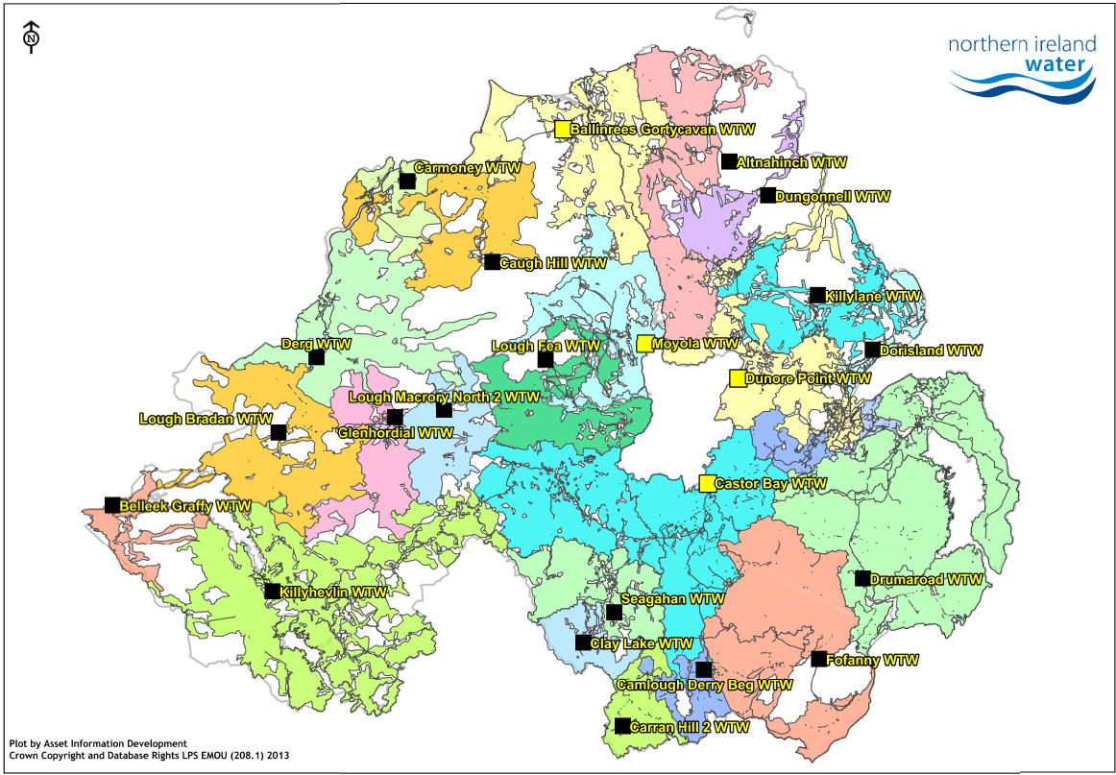
Lough Neagh
Lough Neagh is the largest water body in NI and is essential to water supply
NI Water abstracts an average of 237 ML/D from Lough Neagh, over a third of our total abstraction; We don’t own land in this catchment.
There are many water quality issues in the Lough, including nutrients, pesticides and sediment which have to be dealt with at Castor Bay, Dunore Point, Ballinrees and Moyola.
In 2016 the Lough Neagh Partnership was funded by NIEA to develop a Shoreline Management Plan for the Lough (£39million plus)
NI Water SCAMP work in partnership to keep drinking water quality at the top of the agenda
Lough Neagh Landscape Partnership
Drinking water quality protection
Partnership

Slide 4
SCaMP NI – Lough Neagh
Engagement ongoing with Lough Neagh Landscape Partnership to avail of external funding to improve water quality
Riparian fencing ongoing around Lough shore to protect water quality and enhance wildlife habitats, availing of funding through DAERA EFS scheme
Award Winning Ballinacor Lagoons Wildflower meadows planted
Passive Sampling Project to establish areas of high MCPA in Balinrees catchment – Successfully identified high risk sub-catchment areas to 2% of Bann catchment
Lough Neagh Landscape Partnership
Ballinacor Lagoons Wildflower meadows
Passive Sampling Project –River Bann to L Neagh

Slide 5
Catchment Management ….with
    Lough Neagh Partnership
    Interreg Partners
    SCAMP NI
      Mourne Heritage Trust
      Ulster Wildlife Trust
      Woodlands Trust
      Royal society for the Protection of Birds (RSPB),
      Government bodies - NIEA, CAFRE, DAERA,
      Lough Neagh Partnership,
      Rivers Trust
      National Trust

Slide 6
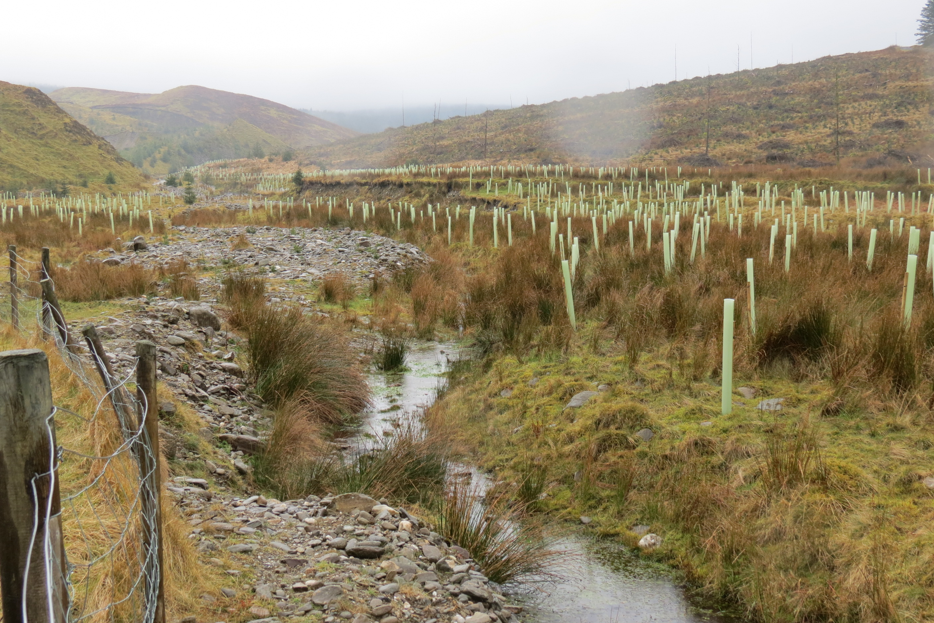
SCaMP NI – Riparian Planting
    Glenedra Riparian Planting – 10,000 native broadleaf trees already planted in 2019 upstream of Glenedra intake. Joint project with Loughs Agency and Woodland Trust
    Stabilises riverbanks to prevent erosion and improve downstream water quality at Carmoney & Caugh Hill WTW
    Reinstates riverbanks damaged after 2017/18 floods in Faughan & Burntullot Rivers
Glenedra Riparian Planting
Lough Fingrean Planting
    Improves water quality for abstraction, wildlife habitats and aquatic life
    Prevents livestock encroachment
Dorisland Infill Planting
Faughan Valley Planting

Slide 7
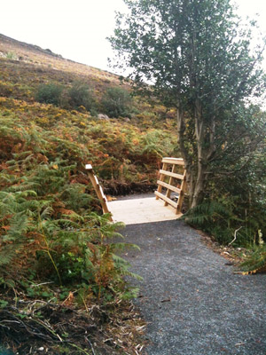
SCaMP NI – Habitat Restoration
    Erosion control In Mournes
    Pathways management
    Invasive Species control ongoing annually in Silent Valley catchment
    Environmental research projects; WRc, UKWIR & Universities
Invasive Species
Habitat Management
Erosion Control
    Facilitation of Recreation and Access
    Invasive species staff guidance, including biosecurity procedures for staff
    Consultations and influence of agricultural and environmental legislation

Slide 8
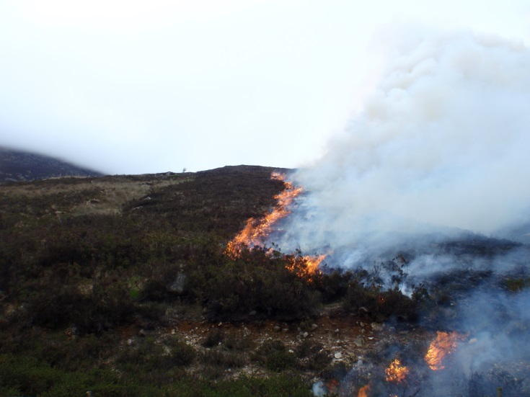
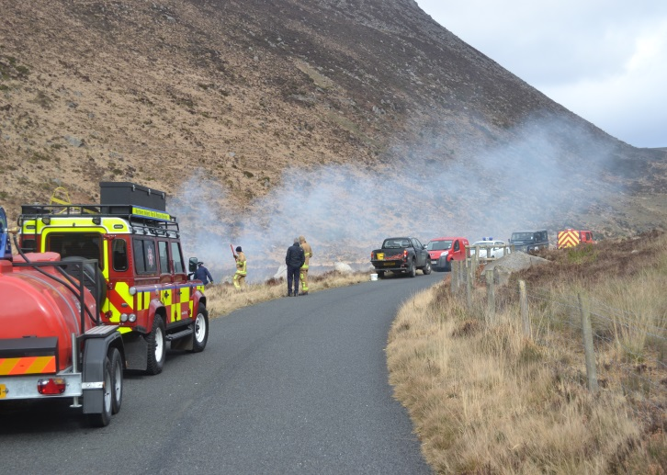
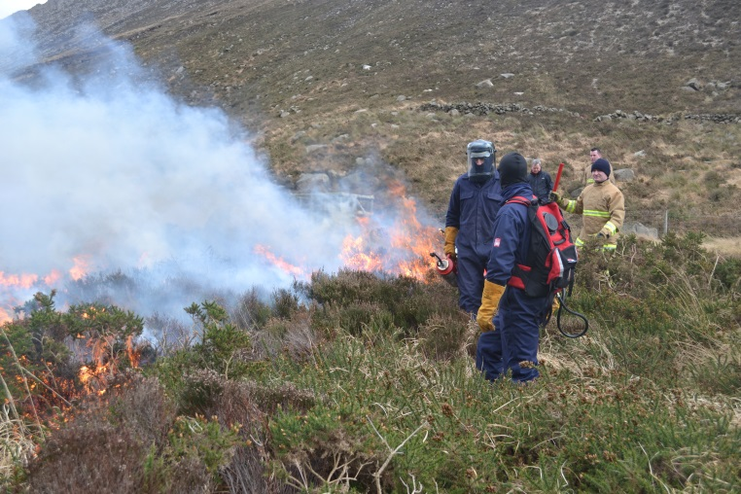
SCaMP NI – Wildfire Control
    Controlled burns planned annually in liaison with NIFRS
    Grazing managed to reduce fuel load in key risk areas
    Recognised as model for fire risk management in UK/Ireland
    Fire Group established with 3 sub-groups:
    Prevention (NIW chair)
    Protection (NIEA chair)
    Intervention & Response (NIFRS chair)

Slide 9
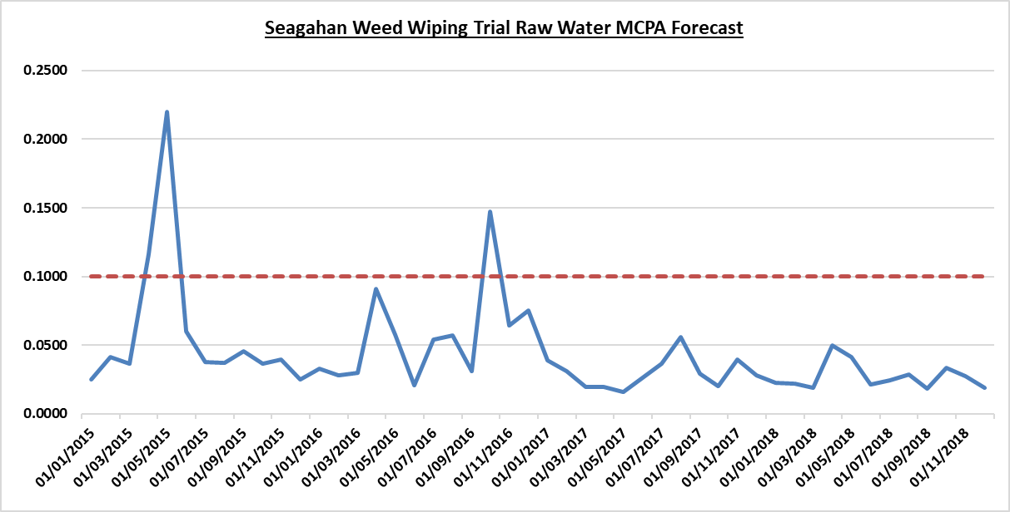
SCaMP NI – Weed-Wiping Projects
    3 Weed-Wiping projects ongoing
    Uses Glyphosate instead of MCPA
    Shown by CAFRE to be more effective form of rush control with less water quality impact
    Successful at reducing MCPA levels in raw water
    Shown to be cost effective:
    Seagahan project cost £25k,
    saving of £50k in GAC costs in 2018
    Excellent PR and cooperation with farming industry
Glenhordial Weed-Wiping
Eden Burn Weed-Wiping
Seagahan Weed-Wiping

Slide 10

SCaMP NI – Interreg CABB with RSPB
    CABB PROJECT - £145K INTERREG funding
    Dungonnell WTW Raw Water quality improvements since 2014:
      Decrease in mean Colour of 3.37%
      Decrease in mean Turbidity of 25.19%
      Decrease in mean TOC of 1.81%
    Wildlife habitat restoration, carbon sequestration
    PR success for NIW – BBC1, RTE, Radio Ulster, etc
2013/14 Bog Restoration project at Garron Plateau
2018/19 CABB INTERREG VA Bog Restoration project
Academic Research by QUB
Hot off the press – Green Apple Gold Award!
Notes:
Co-Operation across Borders for Biodiversity

Slide 11






SCaMP NI – INTERREG Source To Tap with Irish Water
The project covers five areas:
Innovative €5.3m cross-border project
Aims to protect and improve the rivers and lakes within the Derg and Erne catchments.

Slide 12
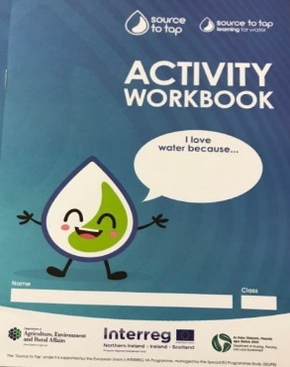
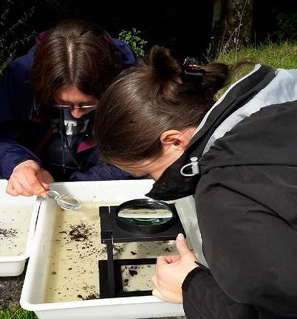


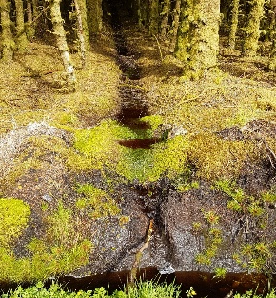


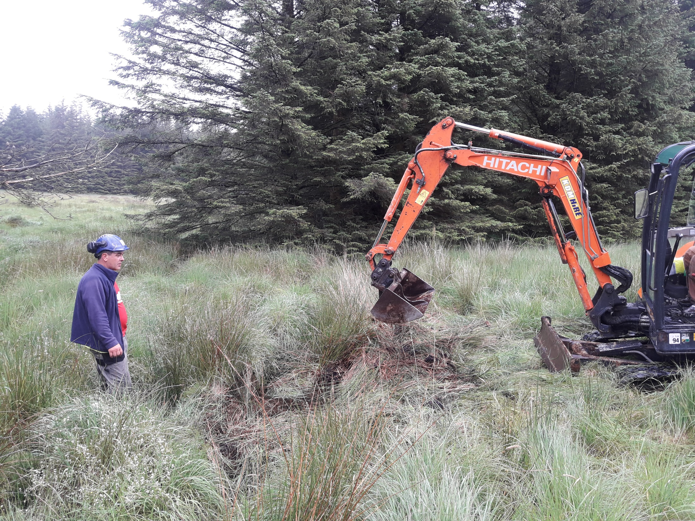

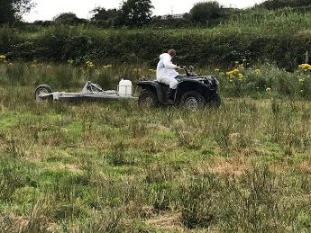
SCaMP NI – INTERREG VA Source To Tap Project
Sustainable Catchment Area Management working in Partnership across the border using INTERREG funding to improve raw water quality in the Erne and Derg catchments
32 volunteers trained in the Riverfly technique in the Erne and Derg catchments. Trigger levels set by EPA and NIEA.
Education booklet developed containing five units being delivered to schools throughout the catchments. General community engagement programme underway to make the connection between our rivers and lakes and where our drinking water comes from.
Trial of peat restoration techniques at Tullychurry near Pettigo Plateau. Monitoring undertaken in partnership with Ulster University.
Working with Forest Service and Coillte to trial and monitor measures above best practice to reduce sediment run-off during and following harvesting. Monitoring undertaken in partnership with Ulster University.
Working with the farming community to implement a pilot land incentive
scheme to change land management practices to reduce herbicide and sediment
run-off. Monitoring work undertaken with AFBI and Ulster.

Slide 13
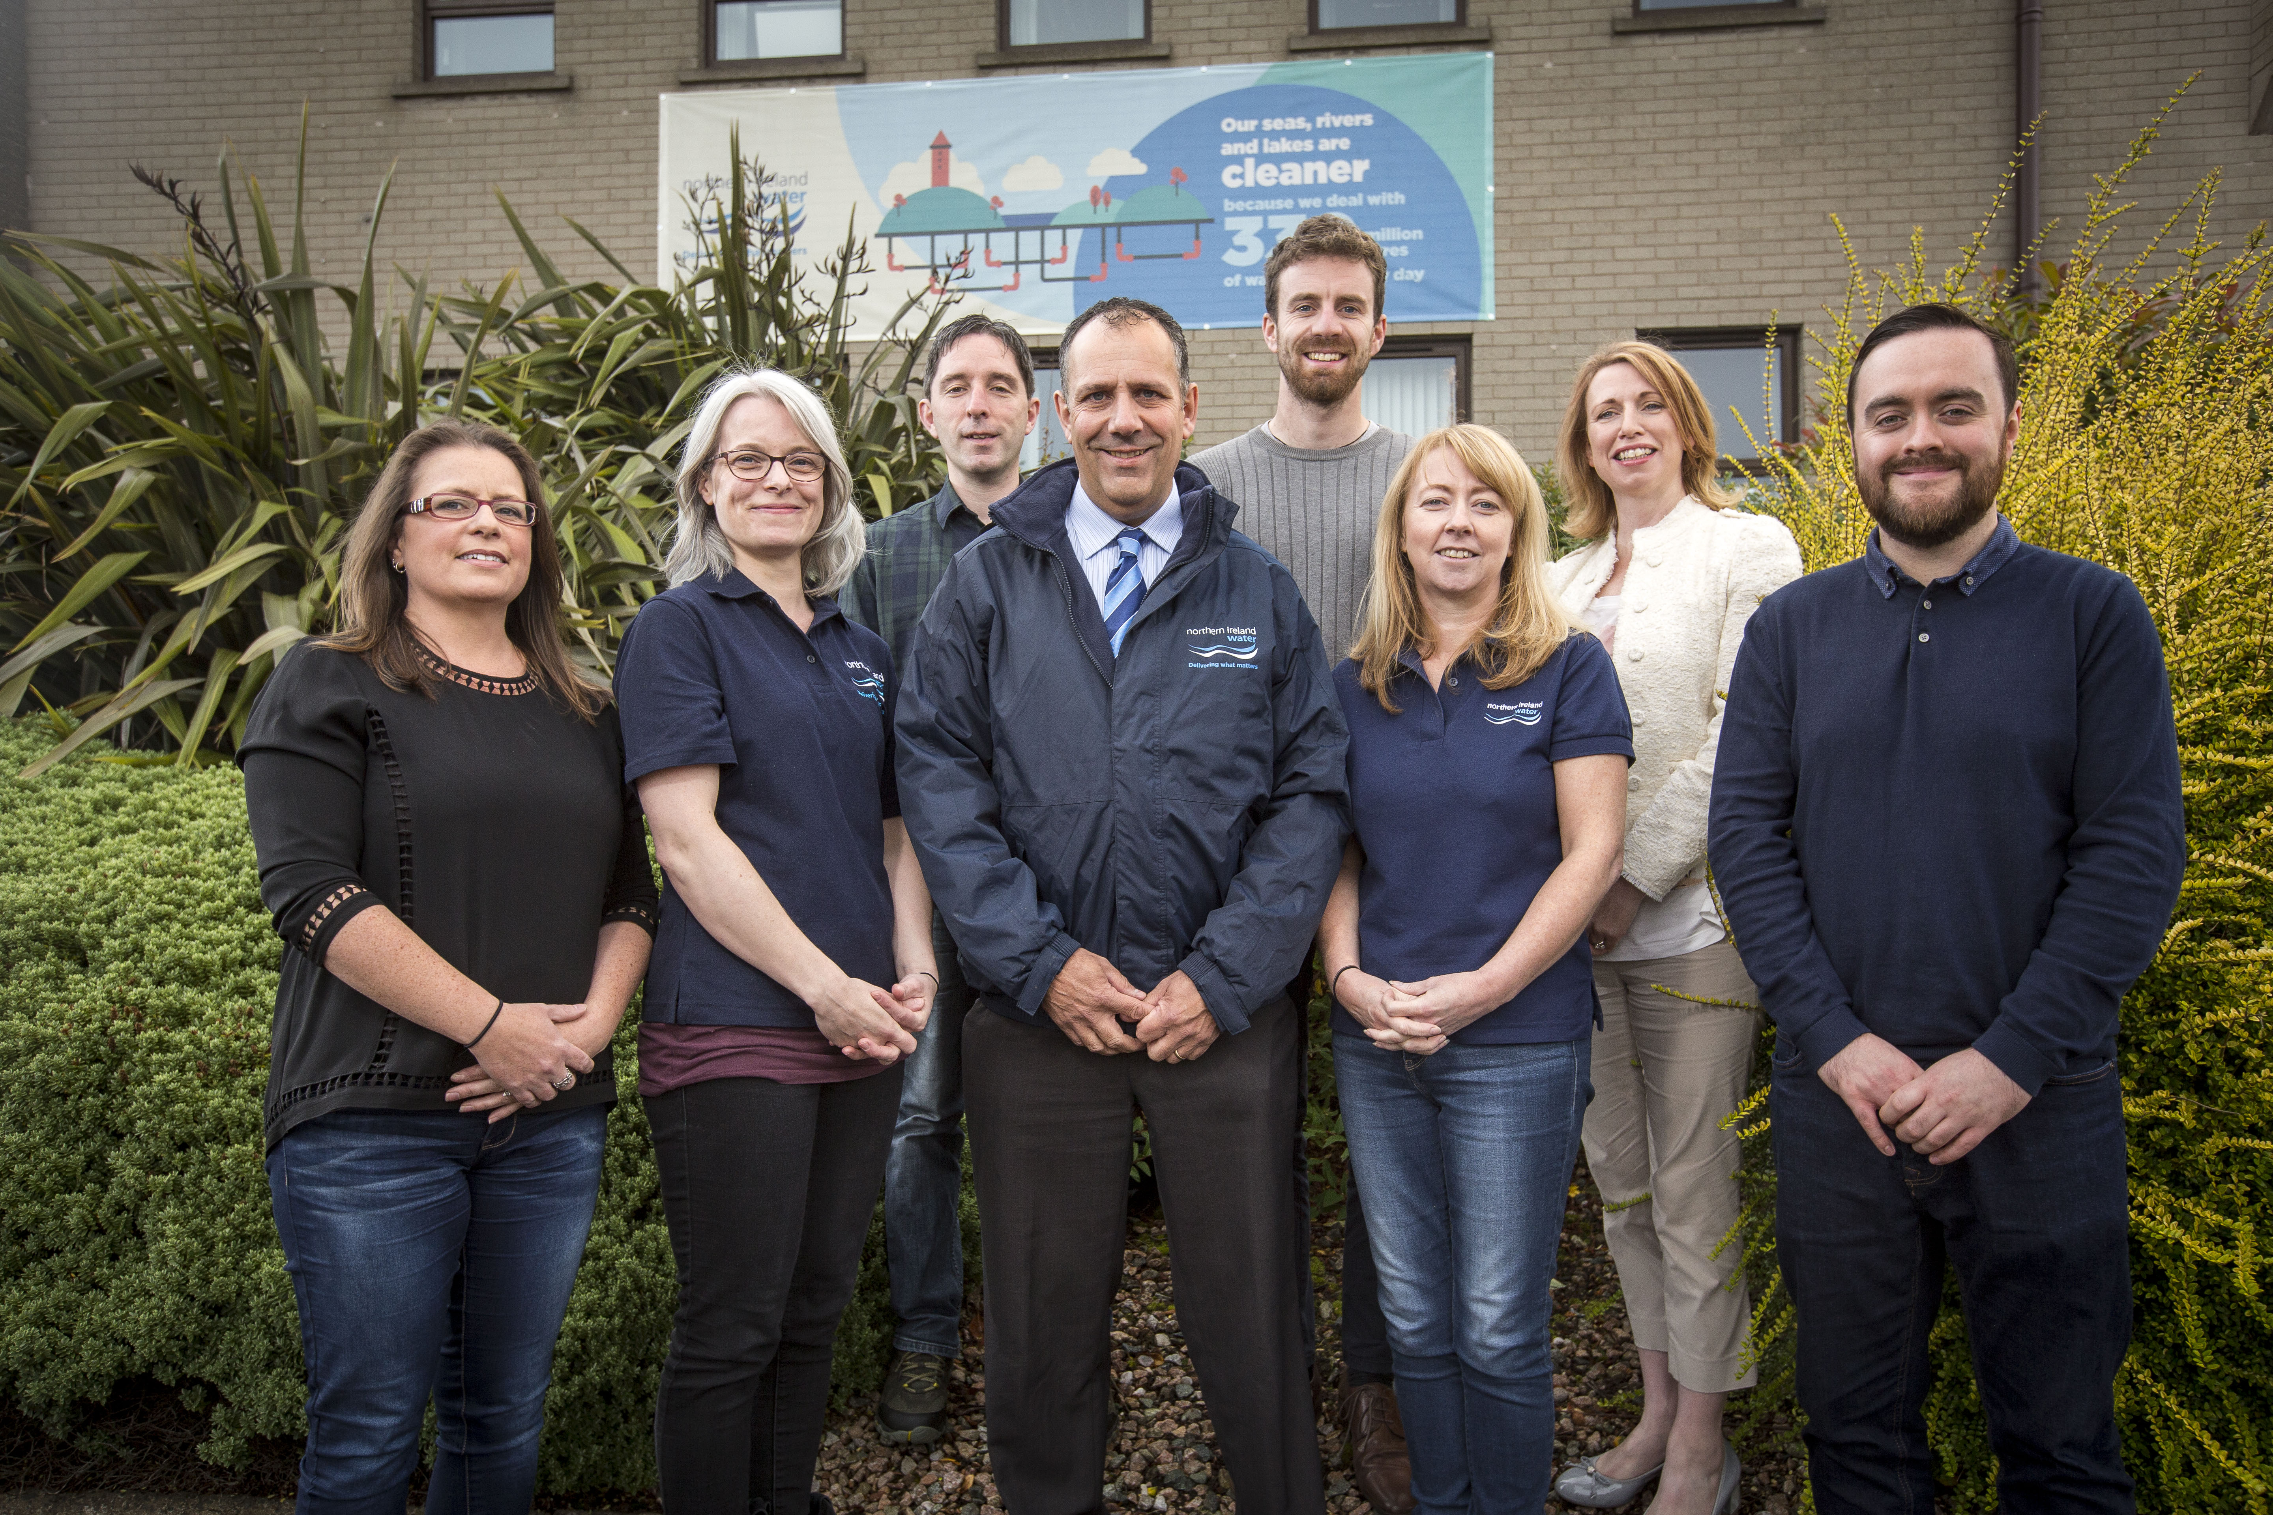

Scampers – for the love of it!!

